Slide 1
IETF L2VPN NTW
EVPN

Slide 2
EVPN support in the L2NM
IETF-L2VPN-NTW/ VPN-Service
Two service-types defined right now.
VLXAN and pure EVPN not defined.
Service Type
PBB-EVPN
VPWS-EVPN
VXLAN-EVPN
EVPN
IETF-L2VPN-NTW/ VPN-Service/VPN-Node
Signaling Options defined at VPN node level. Define the set of configuration parameters of the Node to transport the service.
Now the container includes EVPN-BGP.
Signaling Options
L2VPN-BGP
EVPN-BGP
t-ldp-pwe
l2tp pw

Slide 3
Should the signaling options be aligned with the underlay transport protocols?
How they match nowadays in the model (based on when statement conditions)

Slide 4
The EVPN-BGP can miss some configuration parameters (suggested in the SBI but not in the NBI).
| | +--rw ingress-replication? boolean
| | +--rw p2mp-replication? boolean
| | +--rw arp-proxy? boolean
| | +--rw arp-suppression? boolean
| | +--rw nd-proxy? boolean
| | +--rw nd-suppression? boolean
| | +--rw underlay-multicast? boolean
| | +--rw flood-unknown-unicast-supression? boolean
| | +--rw vpws-vlan-aware? boolean
Available on https://github.com/IETF-OPSAWG-WG/l3nm/pull/194
The EVPN-BGP can miss some configuration parameters (suggested by Qin).
Split Horizon: Now it is supported at Site Network Access level
/l2vpn-ntw/vpn-services/vpn-service/vpn-nodes/vpn-node/vpn-network-accesses/vpn-network-access/connection/split-horizon
Remote-FRR:
Local-remote-FRR
diff-mode
split-mode
ing-diff-mode
eg-diff-mode
Bridge-domain:
Mode-type:
Not Supported

Slide 5
Openconfig Models
EVPN

Slide 6
Network Sample

Slide 7

Typical Telefonica Network
Access
Agg
Core
Agg
Access
HL5: Mobile access
HL4: Fixed Access
IGP: Each aggregation island
Belongs to the same
IGP:
HL4
IP-MPLS
Inter-AS option-C
HL4
HL3
HL3
HL5
HL2
HL2
HL5
HL3
HL3
HL4
HL4

Slide 8
EVPN Service Requirements
Service Types: | ELAN and ELINE.
Flavor | PBB-EVPN
Access to the Network | Service entering to the network at HL3 (datacenter interconnection), HL4 and HL5.
Customer Access | Ethernet access for customer connectivity single and dual homing. Dot1q, QinQ encapsulation type.
Physical connectivity CE-PE | G-PON, FO or DWDM
Resources administration: | Not defined
EVPN

Slide 9
Data Model

Slide 10
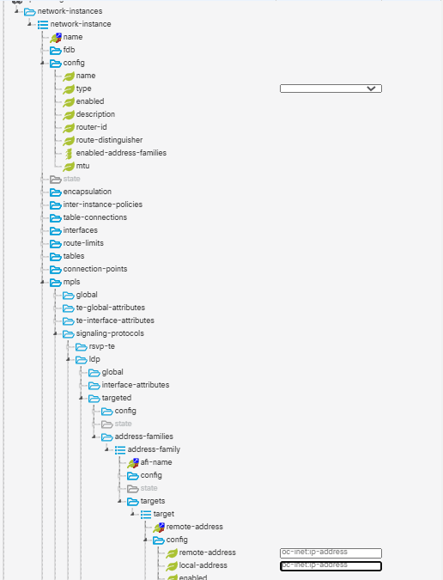
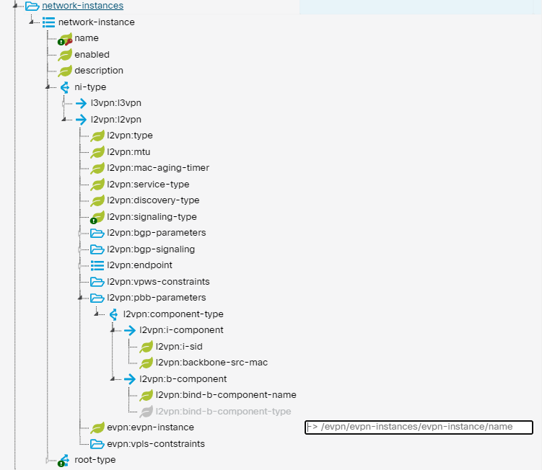
Openconfig EVPN Model
EVPN Service Requirements
openconfig-network-instance
CHANGES AND AUGMENTATION TO BE PERFORMED IN OPENCONFIG-NETWORK-INSTANCE MODULE:
Add a new enumeration instance-type “EVPN” to openconfig-network-instance module
Augment container with “pbb-parameters” as used in ietf-network-instance module
L3VRF
L2VSI
L2P2P
L2L3
DEFAULT_INSTANCE
EVPN
ietf-network-instance
OPENCONFIG-EVPN AUGMENT
OPENCONFIG-EVPN AUGMENT

Slide 11
Proposal
module: openconfig-network-instance
+--rw network-instances
+--rw config
| +--rw name? string
| +--rw type? identityref
| +--rw enabled? boolean
+--rw evpn
| +--rw config
| | +--rw ingress-replication? boolean
| | +--rw p2mp-replication? boolean
| | +--rw arp-proxy? boolean
| | +--rw arp-suppression? boolean
| | +--rw nd-proxy? boolean
| | +--rw nd-suppression? boolean
| | +--rw underlay-multicast? boolean
| | +--rw flood-unknown-unicast-supression? boolean
| | +--rw vpws-vlan-aware? boolean
| +--ro state
---
| +--rw pbb-parameters
| +--rw config
| | +--rw b-component* [b-component-name]
| | +--rw b-component-name string
| | +--rw b-mac-neighbour? oc-yang:hex-string
| | +--rw i-component* [i-sid]
| | +--rw i-sid uint32
| | +--rw backbone-src-mac? oc-yang:mac-address
| +--ro state
---
module: openconfig-bgp
+--rw bgp
+--rw global
| +--rw config
| |
| +--rw use-multiple-paths
| |
| | +--rw evpn
| | +--rw config
| | | +--rw type? identityref
| | | +--rw name? string
| | | +--rw ethernet-segment-identifier? oc-yang:hex-string
| | +--ro state
| | +--ro type? identityref
| | +--ro name? string
| | +--ro ethernet-segment-identifier? oc-yang:hex-string

Slide 12
Proposal
1.
Type: L2EVPN
No Extend encap-type
2.
No Extend type (L2VSI, L2P2P)
Encapsulation: PBB-EVPN; EVPN
SIGNALLING_PROTOCOL: A.P @Oscar
identity BGP_EVPN {
base SIGNALLING_PROTOCOL;
description
"Use BGP-based Ethernet VPN (RFC7432) based signaling for
the network instance";
}
No hay soporte de PBB en los HL5.
¿Cuantas MAC son soportadas por servicio?
¿EVPN is a NI Type or a NI encapsulation?
module: openconfig-network-instance
+--rw network-instances
+--rw config
| +--rw name? string
| +--rw type? identityref
| +--rw enabled? boolean
+--rw evpn
| +--rw config
| | +--rw ingress-replication? boolean
| | +--rw p2mp-replication? boolean
| | +--rw arp-proxy? boolean
| | +--rw arp-suppression? boolean
| | +--rw nd-proxy? boolean
| | +--rw nd-suppression? boolean
| | +--rw underlay-multicast? boolean
| | +--rw flood-unknown-unicast-supression? boolean
| | +--rw vpws-vlan-aware? boolean
| +--ro state
---
| +--rw pbb-parameters
| +--rw config
| | +--rw b-component* [b-component-name]
| | +--rw b-component-name string
| | +--rw b-mac-neighbour? oc-yang:hex-string
| | +--rw i-component* [i-sid]
| | +--rw i-sid uint32
| | +--rw backbone-src-mac? oc-yang:mac-address
| +--ro state
---
module: openconfig-bgp
+--rw bgp
+--rw global
| +--rw config
| |
| +--rw use-multiple-paths
| |
| | +--rw evpn
| | +--rw config
| | | +--rw type? identityref
| | | +--rw name? string
| | | +--rw ethernet-segment-identifier? oc-yang:hex-string
| | +--ro state
| | +--ro type? identityref
| | +--ro name? string
| | +--ro ethernet-segment-identifier? oc-yang:hex-string
BGP-EVPN and move under protocols.
Consider container EVI

